Slide 1
Analyzing and Managing Networks
Linux 2 Day 2

Slide 2
A little history….

Slide 3
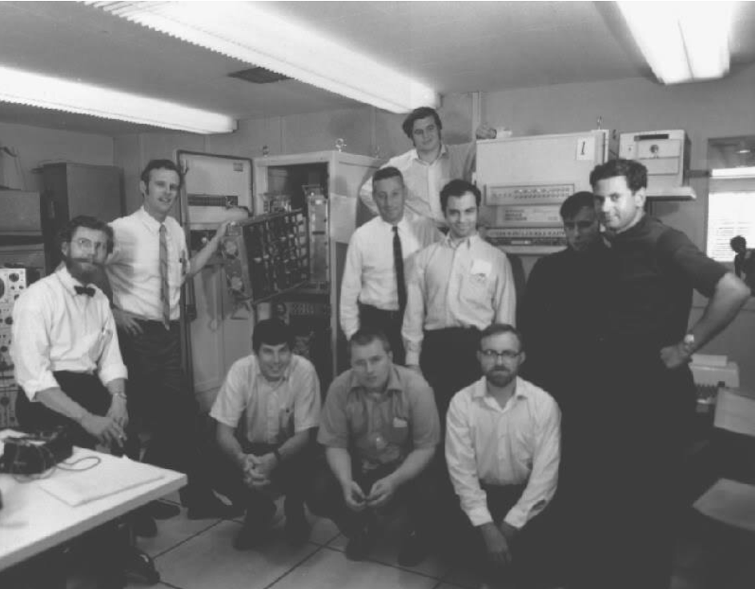
How the Internet was born…
Notes:
On October 29, 1969, an L and an O were sent from a computer at UCLA to a computer at Stanford more than 350 miles away. The letters stood for login, and the effort led to a system crash immediately afterword.
Arpanet was started in the late 1960’s, with military funding, in what the Pentagon hoped would allow American academics to share data sets and valuable computer space.

Slide 4
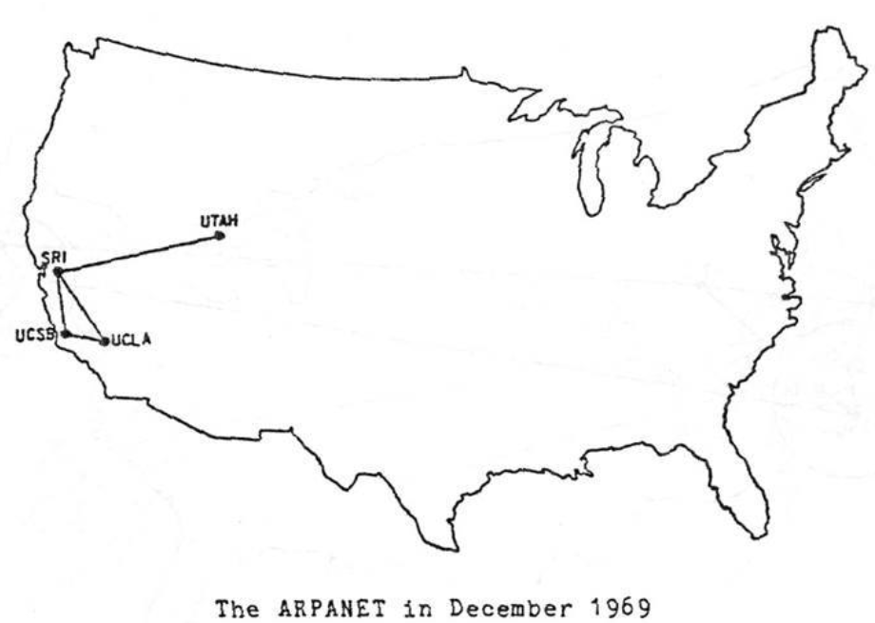
ARPANET
Notes:
At the time, computers were used to project things like missile trajectories, or compute large amounts of data with programs that had to be manually loaded into the machine.
Many military institutions and universities had different types of computers, all with different operating systems and programing languages. One of the early challenges of the internet was finding a way to send data between all these different types of devices in a way they could understand.

Slide 5
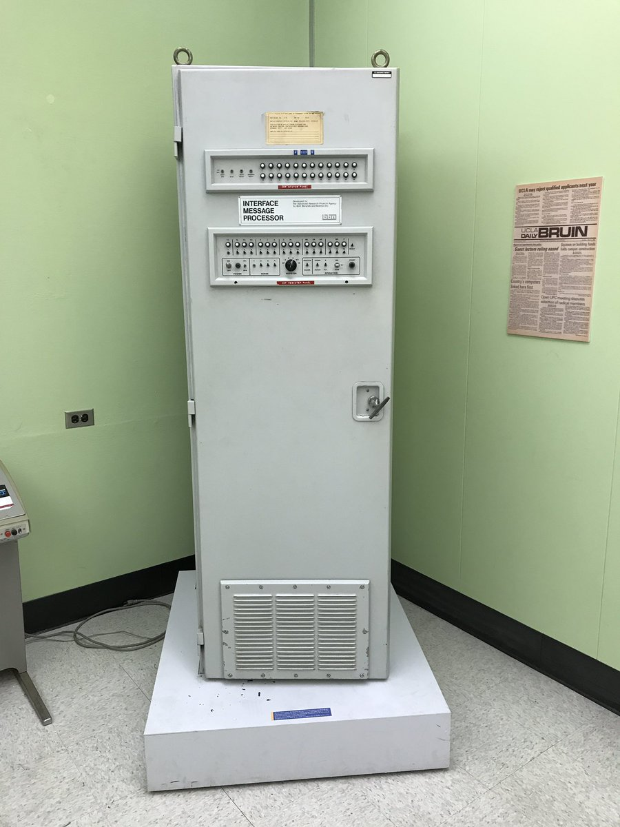
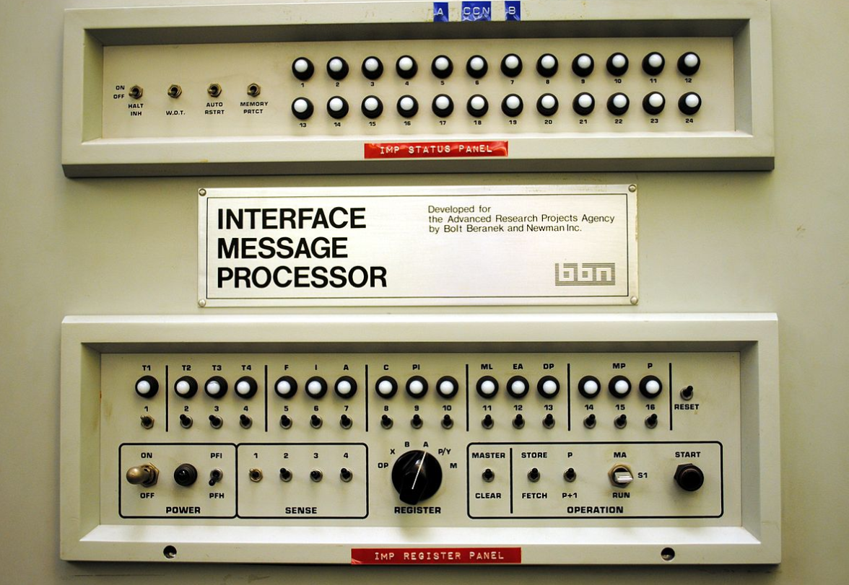
How the Internet was born…
Notes:
And this is the IMP, or Interface Message Processor, the world’s very first router. Today, your cell phone has more power and computing than this device, but this is the piece of equipment that sent the very first command from one computer to another.

Slide 6
ifconfig/iwconfig

Slide 7
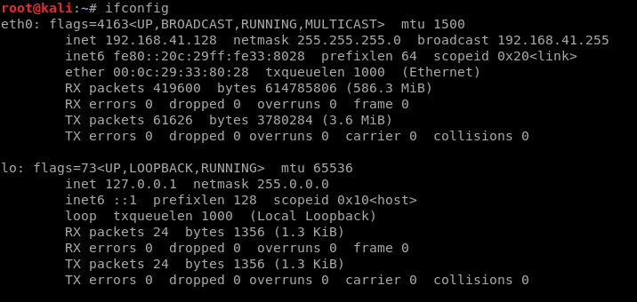

Slide 8
Notes:
1. This is your interface. Linux starts counting at 0. This is your first wired interface.
2. IP address currently assigned to that interface
3. Network Mask / Subnet Mask. Determines which part of the IP is connected to the local network.
4. Broadcast Address – this is the address used to send out information to all IPs on the subnet

Slide 9
Notes:
LO is short for loopback address. This is used so that your computer can talk to programs on the same computer. Local web server, etc.

Slide 10
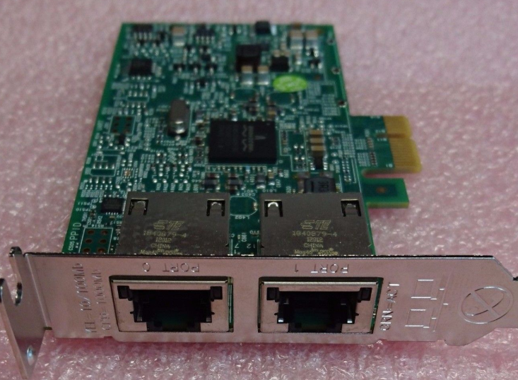
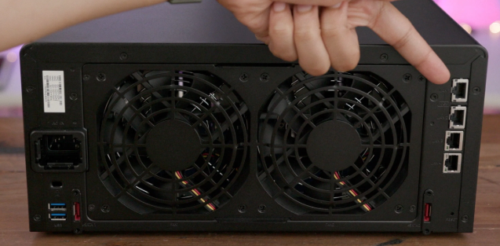
Interfaces
A network interface is a place where a device connects to a network.

Slide 11
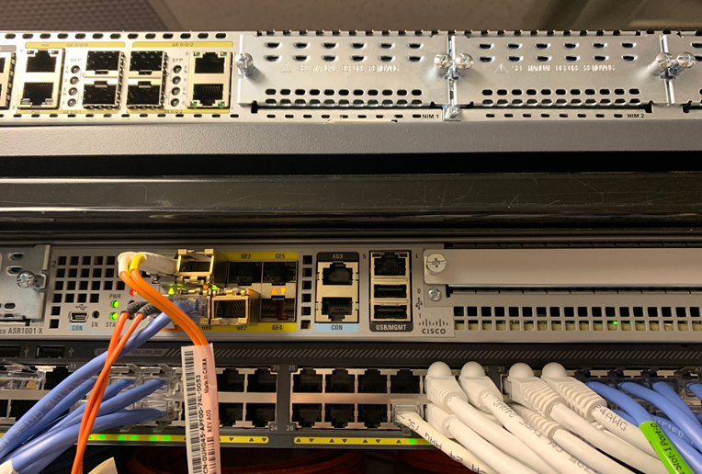
Interfaces

Slide 12
A interface needs to know…
An IP address
A default gateway
A subnet mask
Notes:
* Its IP address. Without this, it doesn't know what traffic is for it and what isn't for it.
* A default gateway. This is where you send traffic that isn't local to you. It's usually the IP address of your router, or firewall, or whatever will be forwarding your traffic on to some other network that is beyond what is local.
* Subnet Mask: Determiens what gets sent to the default gateway vs what is local traffic. Your printer, your TV, your mom's computer, whatever.
* If your subnet mask is incorrect you'll either be sending traffic that's supposed to be local out to computers outside your network or sending traffic ment for the internet will be sent locally, trying to use something like ARP, and timing out.

Slide 13
A interface needs to know…
An IP address
Without this, it doesn’t know what traffic is for it and what isn’t for it.
A default gateway
A subnet mask
Notes:
* Its IP address. Without this, it doesn't know what traffic is for it and what isn't for it.
* A default gateway. This is where you send traffic that isn't local to you. It's usually the IP address of your router, or firewall, or whatever will be forwarding your traffic on to some other network that is beyond what is local.
* Subnet Mask: Determiens what gets sent to the default gateway vs what is local traffic. Your printer, your TV, your mom's computer, whatever.
* If your subnet mask is incorrect you'll either be sending traffic that's supposed to be local out to computers outside your network or sending traffic ment for the internet will be sent locally, trying to use something like ARP, and timing out.

Slide 14
A interface needs to know…
An IP address
Without this, it doesn’t know what traffic is for it and what isn’t for it.
A default gateway
This is where you forward traffic that goes to some other network.
A subnet mask
Notes:
* Its IP address. Without this, it doesn't know what traffic is for it and what isn't for it.
* A default gateway. This is where you send traffic that isn't local to you. It's usually the IP address of your router, or firewall, or whatever will be forwarding your traffic on to some other network that is beyond what is local.
* Subnet Mask: Determiens what gets sent to the default gateway vs what is local traffic. Your printer, your TV, your mom's computer, whatever.
* If your subnet mask is incorrect you'll either be sending traffic that's supposed to be local out to computers outside your network or sending traffic ment for the internet will be sent locally, trying to use something like ARP, and timing out.

Slide 15
A interface needs to know…
An IP address
Without this, it doesn’t know what traffic is for it and what isn’t for it.
A default gateway
This is where you forward traffic that goes to some other network.
A subnet mask
Determines what gets sent to the local network vs what goes to the default gateway.
Notes:
* Its IP address. Without this, it doesn't know what traffic is for it and what isn't for it.
* A default gateway. This is where you send traffic that isn't local to you. It's usually the IP address of your router, or firewall, or whatever will be forwarding your traffic on to some other network that is beyond what is local.
* Subnet Mask: Determines what gets sent to the default gateway vs what is local traffic. Your printer, your TV, your mom's computer, whatever.
* If your subnet mask is incorrect you'll either be sending traffic that's supposed to be local out to computers outside your network or sending traffic ment for the internet will be sent locally, trying to use something like ARP, and timing out.

Slide 16
Let’s say you’re at home…

Slide 17

A packet’s path
I wanna talk to Google….
I’m not Google, so I better use my send the packet to my default gateway…

Slide 18
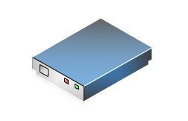
A packet’s path
192.168.1.1
Notes:
Your home router has a little bit more of a complicated decision. It has to figure out if this is on its home network (192.168.1.something) or does it need to go somewhere else. It's not, so I'm going to use MY default gateway, which is your ISP's router.

Slide 19
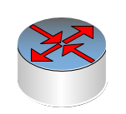
A packet’s path
ISP Router
Notes:
Your ISP has to figure out is this other customer traffic that has to go through one of my other interfaces to talk to customers or do I need keep going.
During all of this, each router asks itself "Do I know where to send this? No? I'm gonna send it to my gateway."

Slide 20
A packet’s path
ISP Router
Notes:
Your ISP has to figure out is this other customer traffic that has to go through one of my other interfaces to talk to customers or do I need keep going.
During all of this, each router asks itself "Do I know where to send this? No? I'm gonna send it to my gateway."

Slide 21
Eventually….
Backbone (Core) Router
Notes:
Eventually, you'll get to a router that knows every direction/decision. It has no default gateway. This is called a backbone router. It is a router that knows, given any IP address, where the packet needs to go.

Slide 22
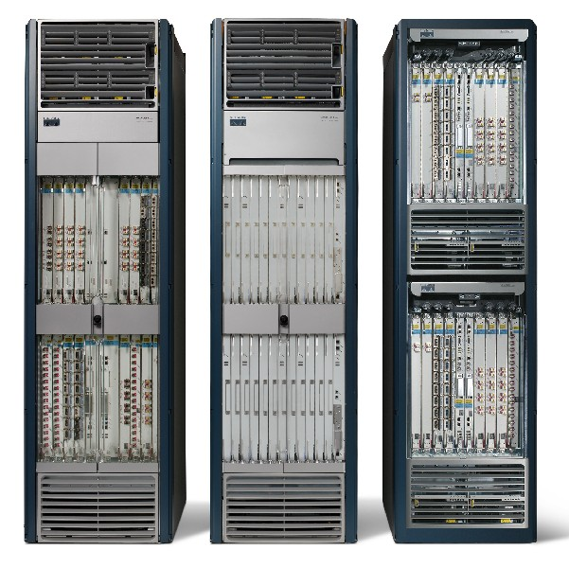
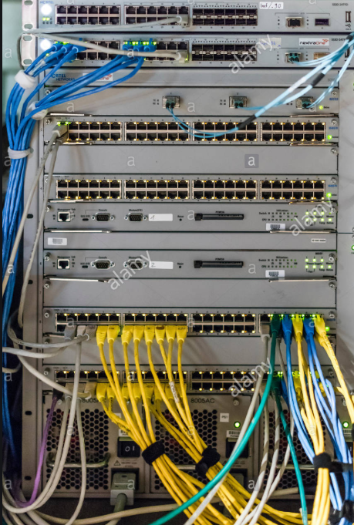
Eventually….
Notes:
Eventually, you'll get to a router that knows every direction/decision. It has no default gateway. This is called a backbone router. It is a router that knows, given any IP address, where the packet needs to go.

Slide 23
Trace Route
Look at the man page and -- help page for traceroute
Use the command to trace the path of a website of your choosing. Take note of how many “hops” occurred.
What do each of these hops indicate?
Run the command again on the same website. Was the same path taken?
Did some “hops” time out? Why?

Slide 24
Linux History and Distros

Slide 25
Common ifconfig Commands

Slide 26
ifconfig
Try to do the following:
Display compact output
Bring the interface up and down
Enable promiscuous mode (and disable)

Slide 27
How the Internet Gives us Away

Slide 28
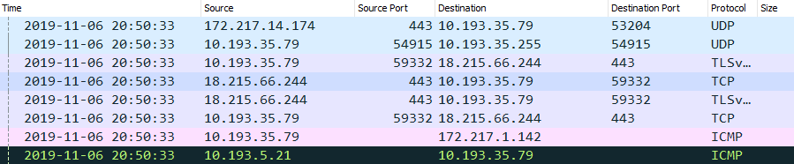
IP addresses
When you send a packet of data across the internet, it contains the IP addresses of the source and destination for the data.
Notes:
As the packet moves across the internet, anyone intercepting it can see who sent it and where it was intended to go, in addition to where it’s been.

Slide 29
Changing your Network Information

Slide 30
MAC addresses
A MAC address is a unique identifier assigned to a network interface controller.
MAC’s have a corresponding IP assigned to them when they are on a network.

Slide 31
IP Addresses vs MAC Addresses
IP Address
It’s like your full street address:
Ernest Cockrell Jr Hall
301 E Dean Keeton St
Austin, TX 78712
MAC Address
The blue house, with the white fence, and the bad dog that barks all the time, with the dead tree.
Notes:
When someone is sending you a letter conventionally, the mail is routed to your local post office based on the full address. We will compare this with routing of IP over the internet. The post office the mail was sent from could care less about your oak tree.
In the conventional method, the post man would organize his deliveries by street, and go house to house delivering the mail

Slide 32
Changing your MAC Address

Slide 33
MAC Changes and Attacks
In this activity, you will use terminal to perform basic task like creating and removing files, extracting archives and cutting up and archiving files.
Instructions sent via Slack.
15 Minutes

Slide 34
Getting Comfy with the CLI

